Slide 1
DB PROGRAMMING RED TEAM PHASE 2 – POPULATE, TEST, AND USE OPERATIONAL DATABASE
Akshay Jadhav
Jaymeen Gandhi
Tejas Joshi
Anmol Kansara
Rashmi Jain
Mayuri Khade

Slide 2
Agenda Jaymeen
Project Requirements
Approach Used
Group Summary and Conclusion
Suggestions

Slide 3
Project Requirements Jaymeen
To populate the Model, Access Rule tables with given data sets
Implement at least two approaches to compare pertinent attributes between MODEL and ACCESS RULE tables and to gather mismatched records from MODEL table called ‘evidence of discrepancies’ into DISCREPANCY table for better evaluation of discrepancies.
To select best approach to implement the comparison operation in the given system.

Slide 4
Approach Used Jaymeen
LEFT JOIN Approach
CURSOR Approach

Slide 5
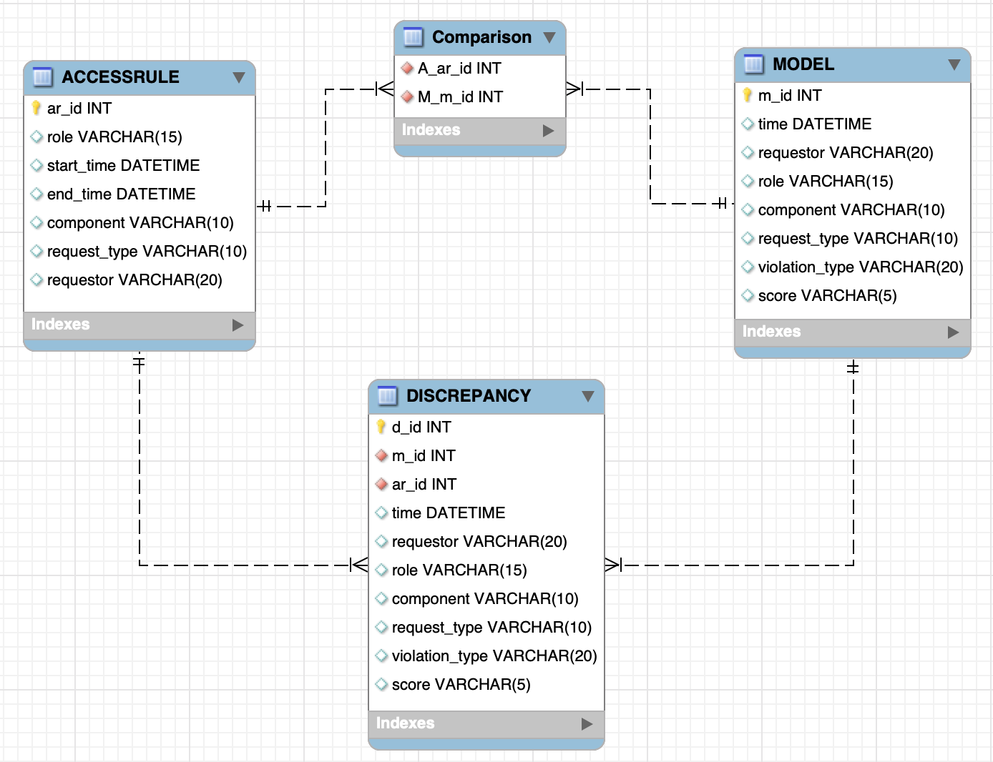
LEFT JOIN (Updated ERD) Jaymeen

Slide 6
LEFT JOIN (Pseudo Code) Akshay
Fetch all MODEL records from MODEL table for score is TRUE and all ACCESS RULE table, inserted into Comparison table.
Using JOIN approach, performed comparison of pertinent attributes by comparing each row of MODEL with each row of ACCESS RULE table, to get all mismatched rows(called “Evidences of Discrepancy)
Inserted mismatched rows between MODEL and ACCESS RULE table into DISCREPANCY table after comparison to gather the evidences of discrepancy.
Created a stored procedure to gather evidence of discrepancies happened during comparison between MODEL and ACCESS RULE table.

Slide 7
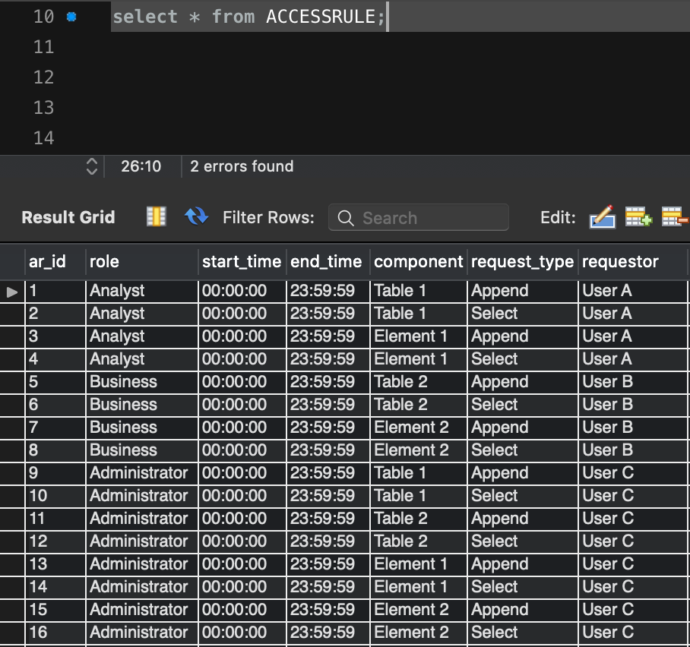
Population of Tables Akshay
ACCESSRULE
Total rows: 16

Slide 8
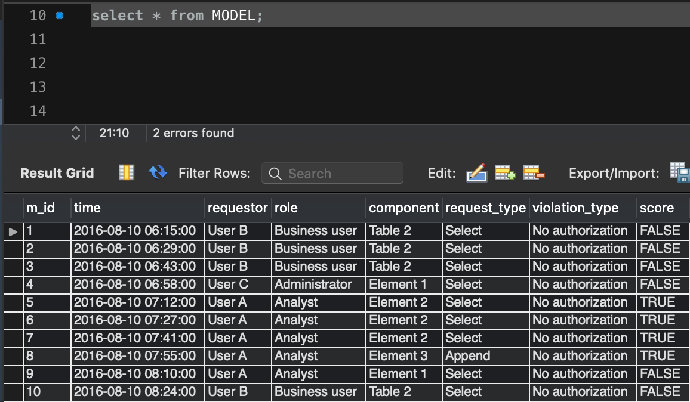
Population of Tables Akshay
MODEL
Total rows: 20266

Slide 9
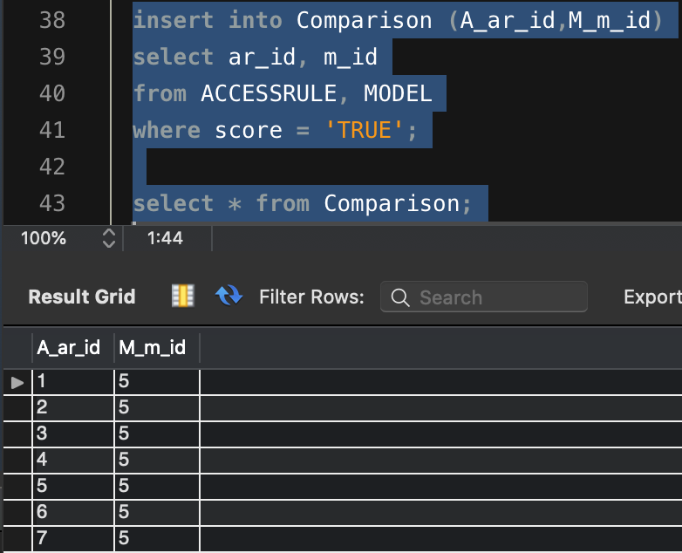
LEFT JOIN (Implementation) Akshay
For each row from MODEL table having score TRUE, fetch each row from ACCESS RULE table and insert ar_id, m_id into Comparison table.
Row Count: 38080

Slide 10
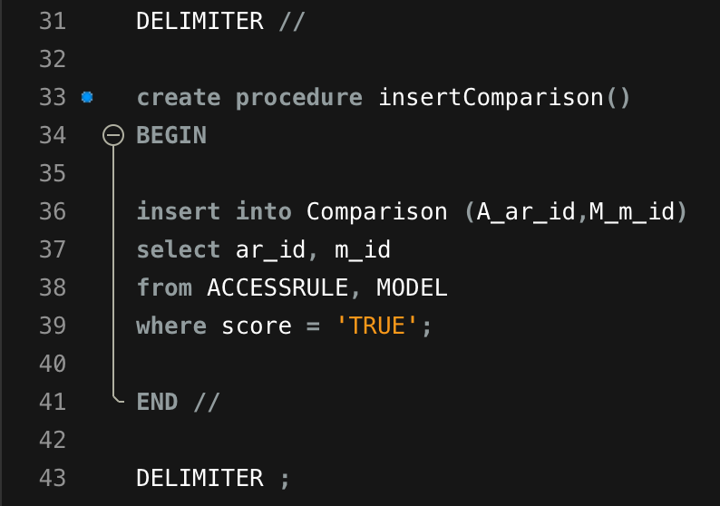
LEFT JOIN (Implementation) Akshay
Created a stored procedure insertComparison() for the same to insert records into Comparison table from both MODEL and ACCESS RULE table.

Slide 11
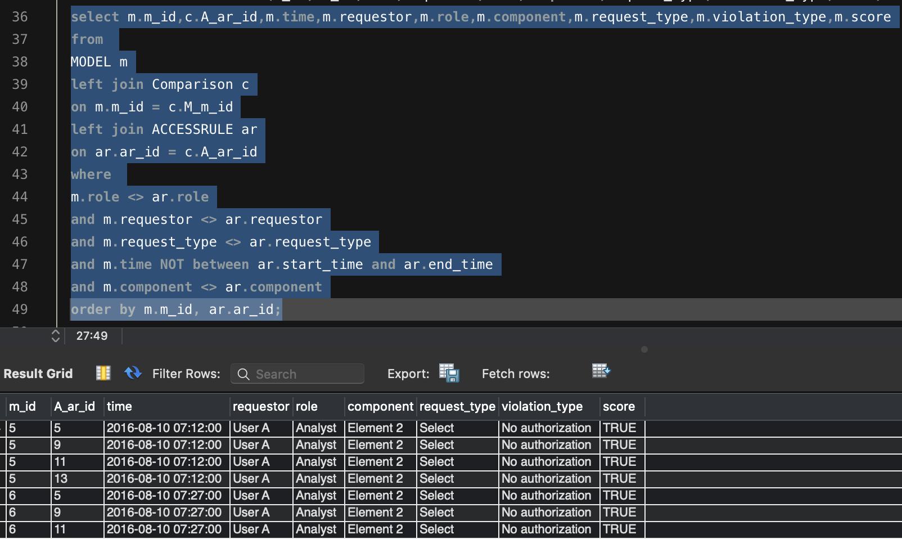
LEFT JOIN (Implementation) Akshay
Fetched all mismatched rows (evidences of discrepancy) from MODEL table after comparison of pertinent attributes from both MODEL table and ACCESS RULE table.
Mismatched count (Evidence of Discrepancy): 9860

Slide 12
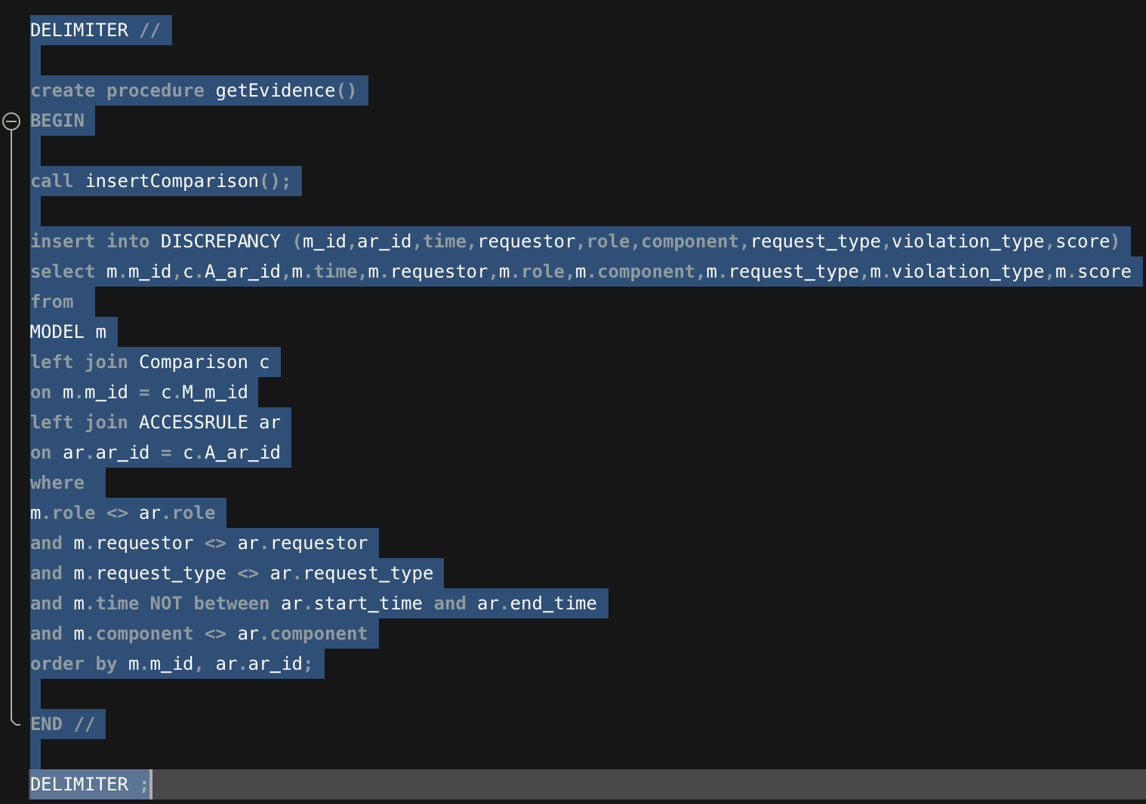
LEFT JOIN (Implementation) Akshay
Created a stored procedure i.e. getEvidence() to get all evidence of discrepancies happened during comparison between MODEL and ACCESS RULE table.

Slide 13
Population of Tables Akshay
ACCESSRULE
Total rows: 16

Slide 14
Population of Tables Akshay
MODEL
Total rows: 20266

Slide 15
LEFT JOIN (Implementation) Akshay
For each row from MODEL table having score TRUE, fetch each row from ACCESS RULE table and insert ar_id, m_id into Comparison table.
Row Count: 38080

Slide 16
LEFT JOIN (Implementation) Akshay
Created a stored procedure insertComparison() for the same to insert records into Comparison table from both MODEL and ACCESS RULE table.

Slide 17
LEFT JOIN (Implementation) Akshay
Fetched all mismatched rows (evidences of discrepancy) from MODEL table after comparison of pertinent attributes from both MODEL table and ACCESS RULE table.
Mismatched count (Evidence of Discrepancy): 9860

Slide 18
LEFT JOIN (Implementation) Akshay
Created a stored procedure i.e. getEvidence() to get all evidence of discrepancies happened during comparison between MODEL and ACCESS RULE table.

Slide 19
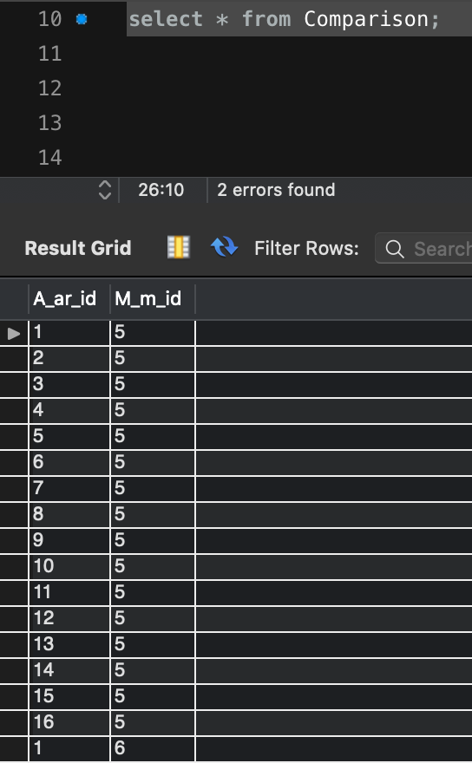
Population of Tables Akshay
Comparison
Total rows: 38080

Slide 20
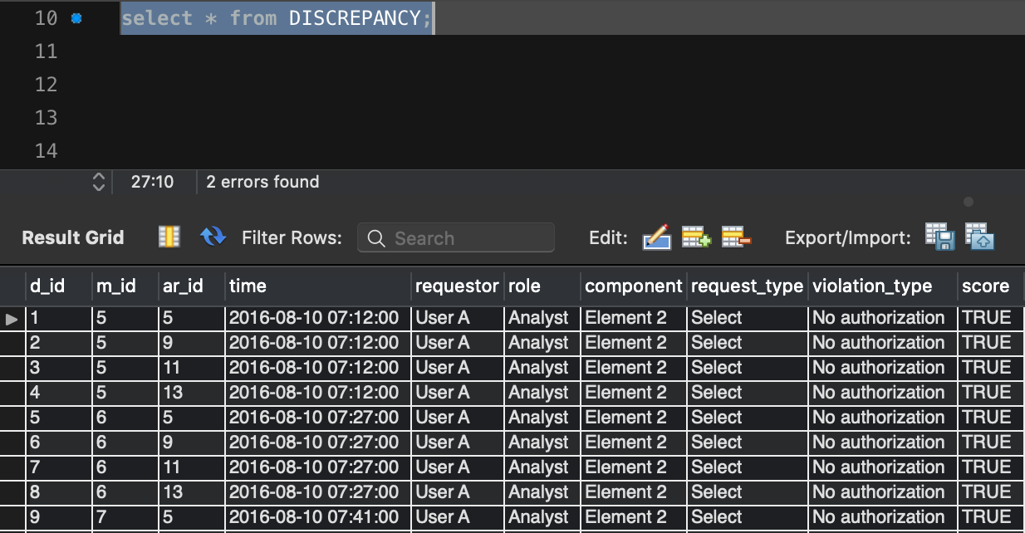
Population of Tables Akshay
DISCREPANCY
Total rows: 9860

Slide 21
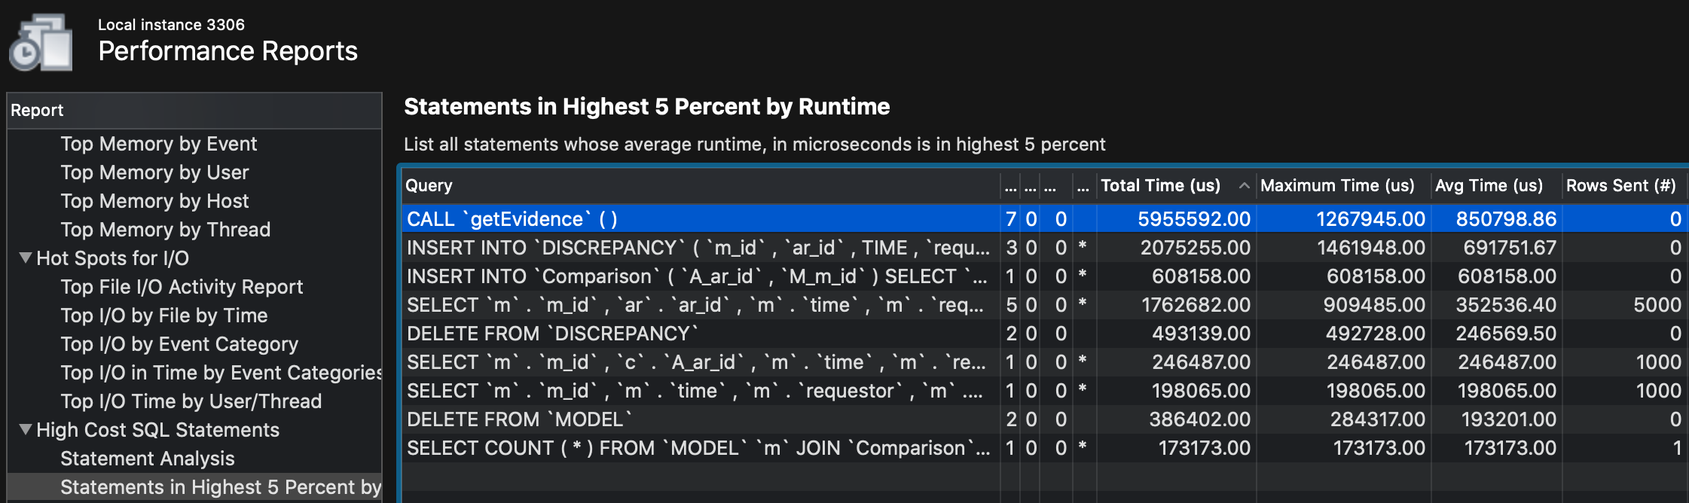
LEFT JOIN (Performance Report) Akshay
Total Time: 5955592.00 microsec → 5.95 seconds

Slide 22
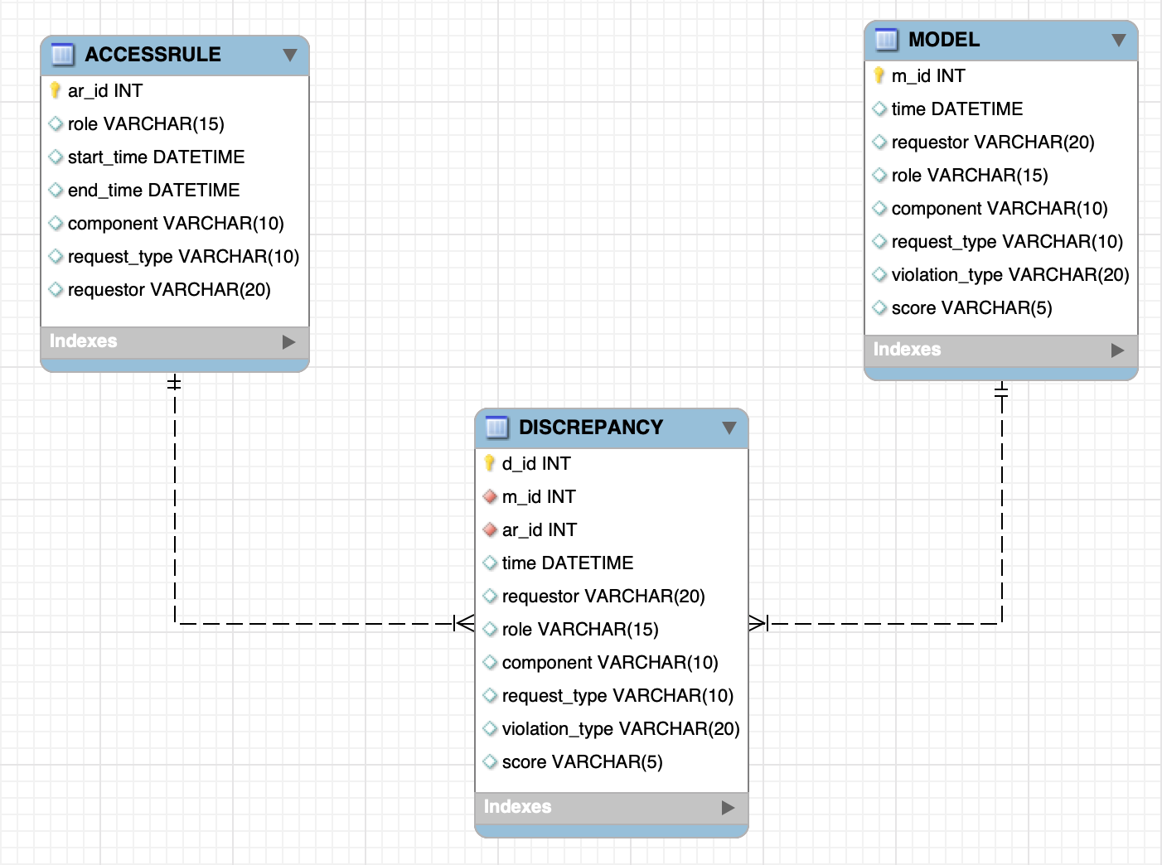
Cursors (Updated ERD) Tejas

Slide 23
Cursors (Pseudo Code) Mayuri
We have created a stored procedure called getEvidenceByCursor().
Declared all variables which are required.
Uses two cursors, for MODEL and ACCESS RULE table respectively.
Uses IF loop to compare all pertinent attributes from MODEL and ACCESS RULE table.
Based on comparison, mismatched rows between MODEL and ACCESS RULE will be inserted into DISCREPANCY table.

Slide 24
Population of Tables Mayuri
ACCESSRULE
Total rows: 16

Slide 25
Population of Tables Mayuri
MODEL
Total rows: 20266

Slide 26
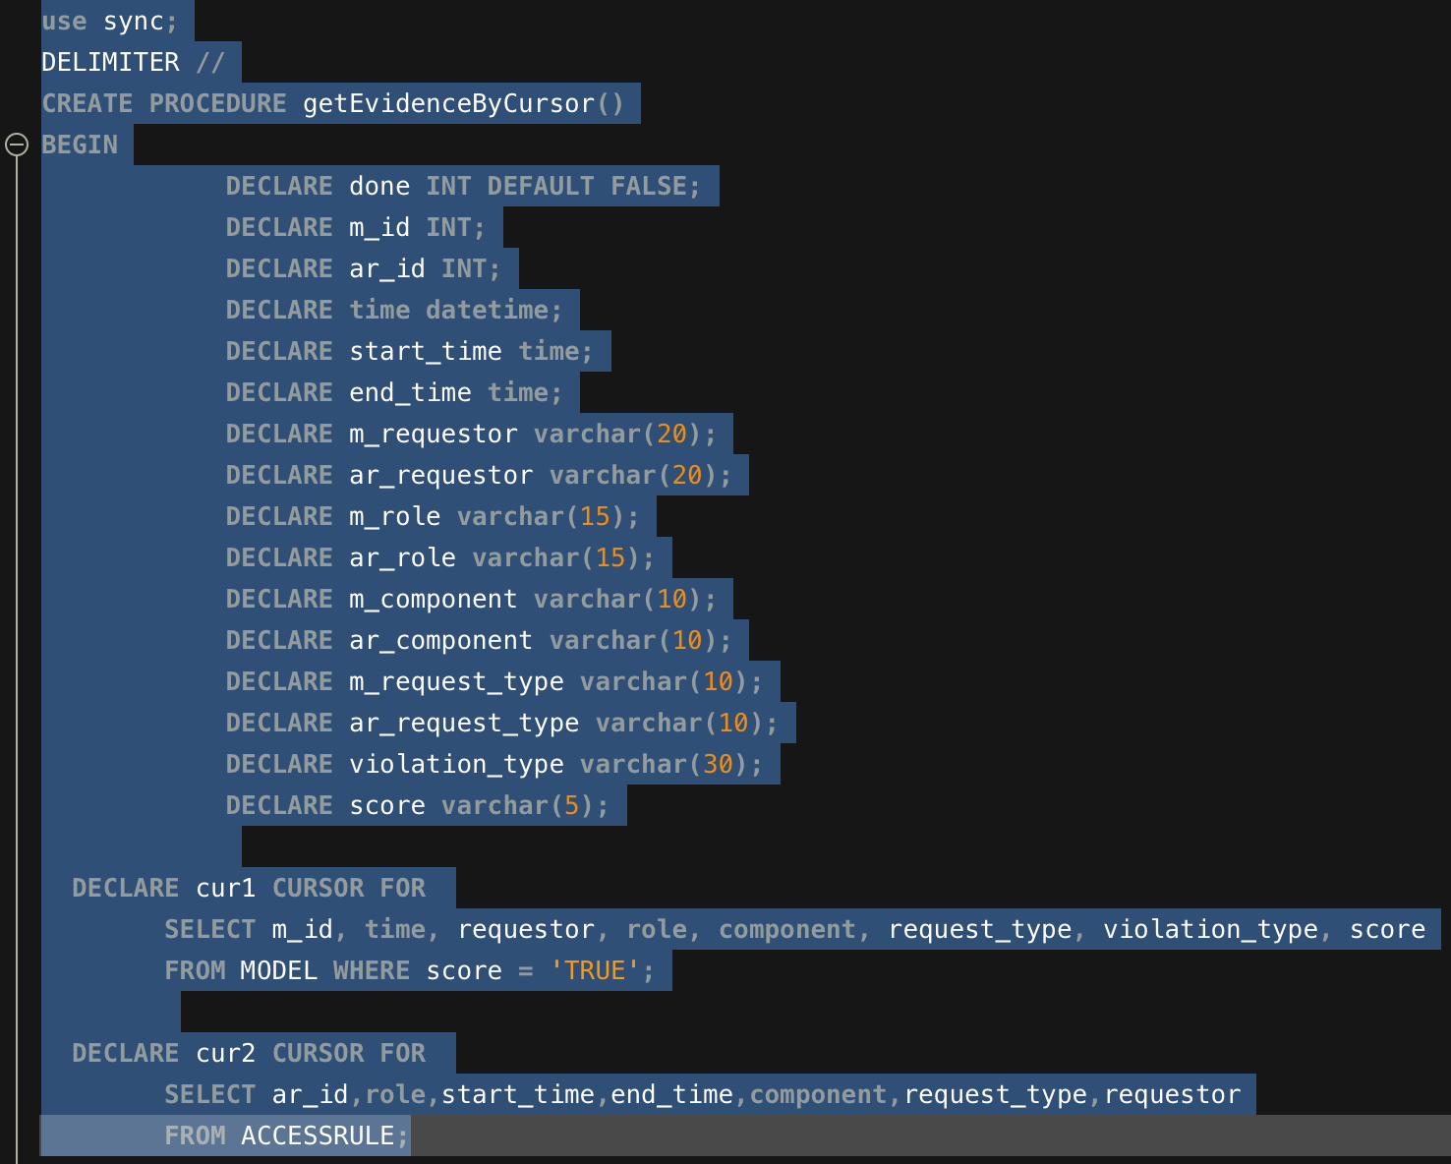
Cursors (Implementation) Anmol

Slide 27
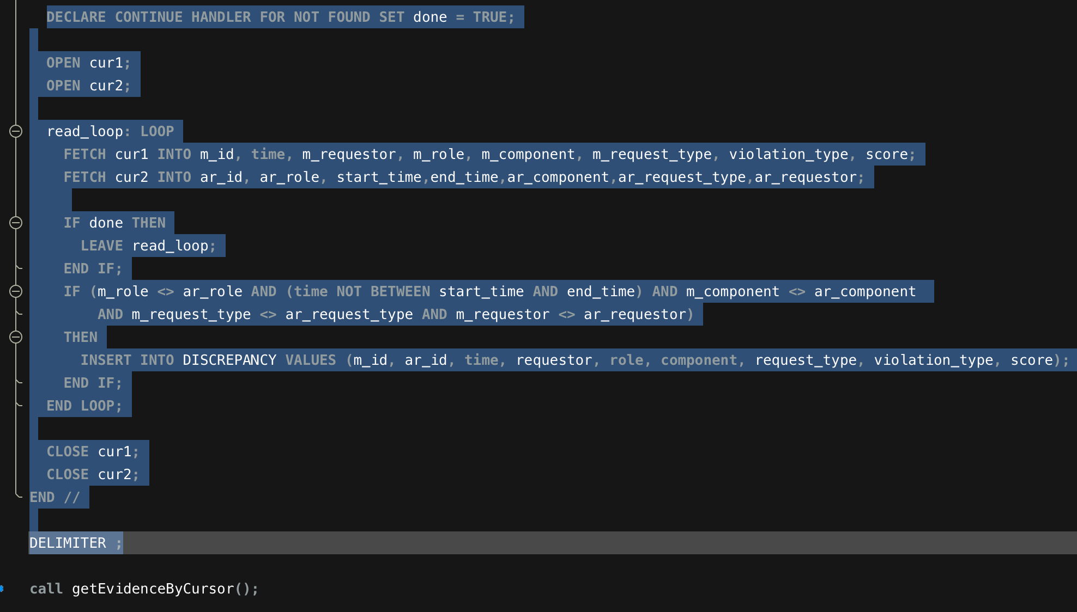
Cursors (Implementation) Anmol

Slide 28
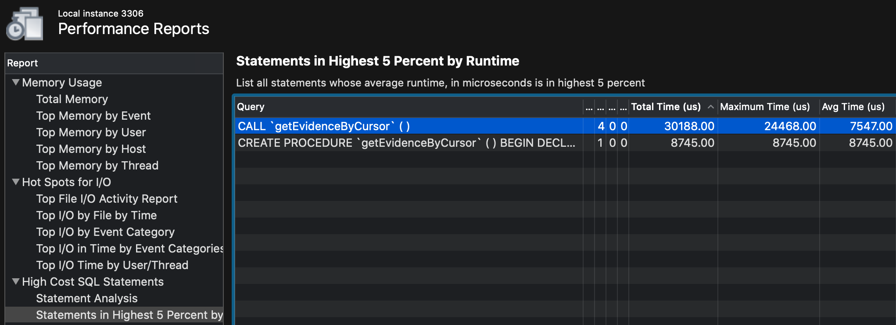
Cursors (Performance Report) Rashmi
NOTE: Unfortunately, procedure is not working properly with Cursor approach to perform comparison operation. (So Total Time in performance report will be different in working scenario)

Slide 29
Group Summary & Conclusion Akshay
We have populated the MODEL and ACCESS RULE tables with given data set.
We have performed two approaches to do a comparison operation between pertinent attributes of MODEL and ACCESS RULE table i.e. LEFT JOIN, and CURSOR.
With LEFT JOIN approach, we have got 9860 mismatched records (called ‘evidence of discrepancy’) between MODEL and ACCESS RULE table after comparison operation. (Total time: 5.95 seconds)
Unfortunately, with CURSOR approach, we have not able to fetch the expected mismatched records between MODEL and ACCESS RULE table and unable to gather evidences in DISCREPANCY table.

Slide 30
Suggestions Rashmi
According to real time use of Cursors, the approach uses more network bandwidth which ultimately degrade the speed of the operations.
Due to such poor performance, cursors are not recommended approach.
We recommend the JOIN approach over CURSOR approach, to get overall good performance for the implemented system with much less execution time.

Slide 31
Thank You

